Slide 1
Title: Data-Driven Salary Analysis in the Indian IT Sector, Trends and Insights
Subtitle: Automating Data Workflow from S3 to Snowflake
Presented by: Kruthi R

Slide 2
Dataset Format
Position: QNXT Configuration QA/Testing SME
Location: Ghaziabad
Gender: Female
Education: B.Tech/B.E.
Experience: 11 years
Salary: ₹2,014,510
Total number of records in the dataset is 3353

Slide 3
Uploading Files to S3
Objective: Upload local files to an S3 bucket using Python.
Steps:
Import libraries (os, boto3).
Configure the S3 client with AWS keys.
Specify local file path and S3 bucket.
Use upload_file method to upload files.
Outcome: Files successfully uploaded to the S3 bucket.

Slide 4





Technology Stack
Python
AWS Cloud

Slide 5
Design Architecture
Local Data Source → AWS S3 Bucket (highestpaidjobss.csv) → Python & Boto3 (Uploading the file)
↓
Snowflake External Stage
↓
Staging Schema (Creating stage for highestpaidjobs.csv)
↓
Dimension Schema
├── employee_data (Positions, Location, Gender, Education, Experience, Salary)
↓
Key Performance Indicators (KPIs):
├── Average Salary for 'DIPLOMA'
├── Average Salary for 'B.Tech/B.E.', 'BCA'
├── Highest Salary by Position
├── Minimum Salary Details
└── Suggested Position based on Salary

Slide 6
Snowflake Setup
Objective: Set up Snowflake database and schema for data ingestion.
Steps:
Create a database (salary).
Create and use a schema (analysis).
Define employee_data table with required columns.
Outcome: Snowflake ready for data loading and analysis.

Slide 7
Configure File Format
CSV Format Creation:
Define a Snowflake file format (CSV_FORMAT) for handling CSV files.
Stage Configuration
Create Stage:
Create an external Snowflake stage (highestpaidjobs) linked to the S3 bucket.
Verify Files:
Use LIST @highestpaidjobs to confirm that the file is accessible from Snowflake.
Load Data into Snowflake
Data Loading:
Use the COPY INTO command to load data from the S3 stage into the employee_data table.
Validation:
Query the table to ensure data is loaded correctly.

Slide 8
Key Insights Derived from the Data Pipeline
Average Salary for 'DIPLOMA' Analysis of the average salary for employees with a diploma education.
Average Salary for 'B.Tech/B.E.' and 'BCA' Insights into the average salary for employees with these educational qualifications.
Highest Salary by Position Identification of the positions offering the highest salaries.
Minimum Salary Details Information about the position and details of the employee with the lowest salary.
Suggested Position Based on Salary Recommendations for employees to transition to higher-paying positions based on the current salary trends.

Slide 9
Reasons for choosing these technologies
Scalable & Efficient: Combines AWS S3 for storage and Snowflake for analytics.
Automated Workflows: Python scripts and Snowflake tasks ensure seamless data processing.
Reliable Data Pipeline: Organized schemas maintain integrity and prevent data loss.
Actionable Insights: Delivers KPIs for decision-making, like salary trends and recommendations.
Cost-Effective: Cloud-native tools optimize performance and reduce costs.

Slide 10
KPIs
Average Salary for 'DIPLOMA': Average salary of diploma holders is Rs.1520430.034722
Average Salary for 'B.Tech/B.E.' and 'BCA': Average salary is Rs.1484611.870196
Minimum Salary Details: BMC CONTROL ADMIN with salary of Rs.24,99,925..Lowest is SECURITY PROFESSIONAL - Rs.5,02,689
Highest Salary by Position: Suggested Position Based on Salary: Recommends career shifts to higher-paying roles, based on current salary data and potential growth opportunities..To enhance career prospects and increase earning potential, a Security Professional with a B.A. degree earning ₹5,02,689 annually can pursue certifications like Certified Ethical Hacker (CEH) or AWS Certified Solutions Architect to transition into higher-paying cybersecurity or cloud roles. For a significant salary boost, consider BMC Control-M Certification, leading to roles like BMC Control Administrator with earning potential up to ₹24,99,925 annually.

Slide 11
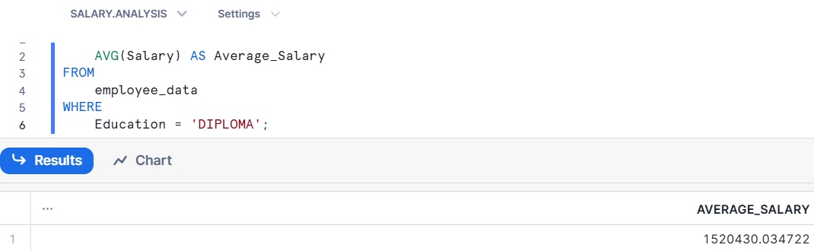
USE cases
1. Compensation Benchmarking
Purpose: Evaluate salary distributions across positions, locations, and educational qualifications.
Key Queries:
Average salary for diploma holders (Query 1).
Average salary for degree holders (Query 2).
Use Case: Helps organizations ensure competitive compensation to attract and retain talent.

Slide 12
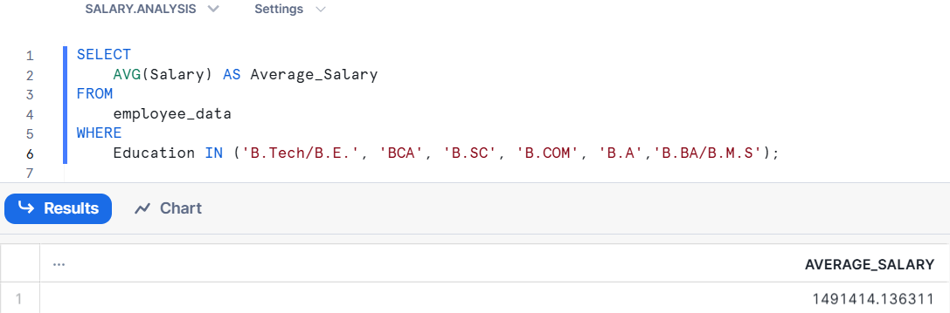
Average salary for degree holders (Query 2).

Slide 13
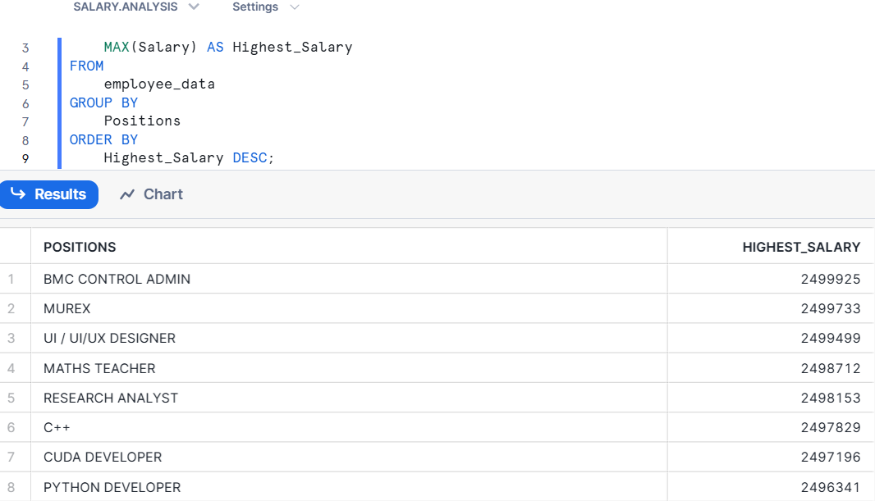
2. Identifying High-Value Positions
Purpose: Determine which positions command the highest salaries within the organization.
Key Queries:
Maximum salary for each position in descending order (Query 3).
Use Case: Assists HR and management in identifying roles critical to organizational success and prioritizing resource allocation.

Slide 14
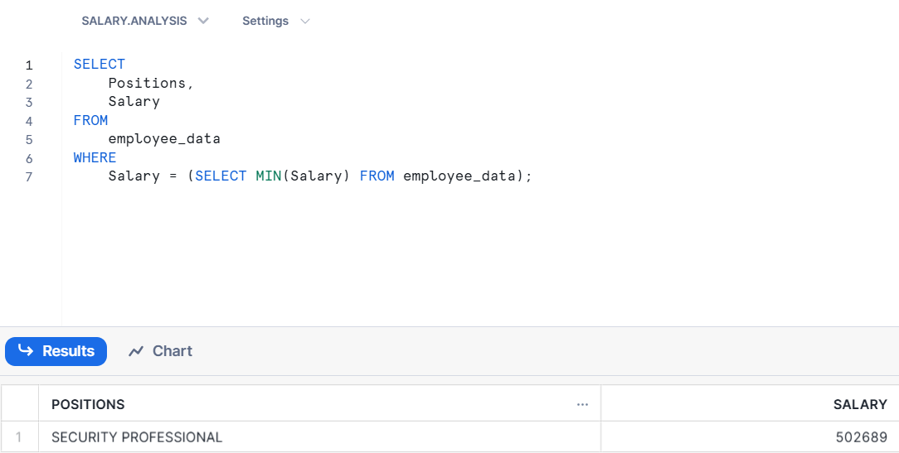
3. Equity and Salary Adjustment Analysis
Purpose: Spot employees with the lowest salaries and identify areas where adjustments may be necessary.
Key Queries:
Employees with the lowest salary (Query 4).
Use Case: Ensures fairness in pay, reduces dissatisfaction, and maintains employee morale.

Slide 15
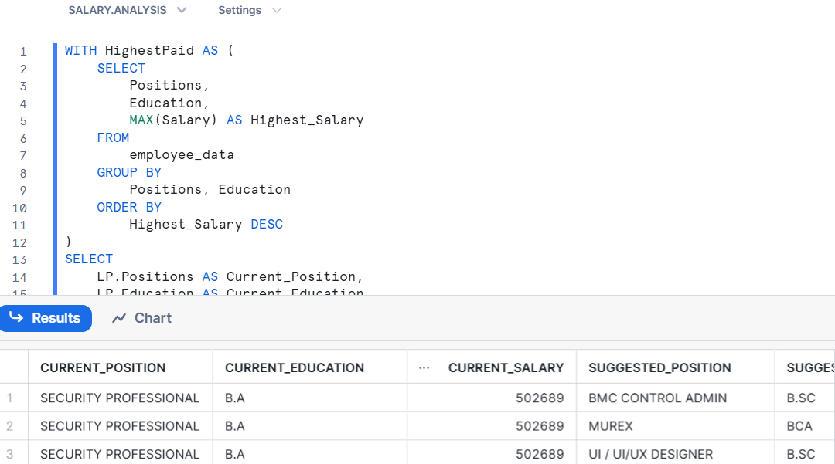

4. Career Path Guidance
Purpose: Suggest higher-paying roles to employees in low-paying positions, promoting career growth.
Key Queries:
Career suggestions for lowest-paid employees by mapping their positions to higher-paying roles (Query 5).
Use Case: Helps employees transition into more rewarding roles, improving job satisfaction.

Slide 16
5. Workforce Analytics by Education
Purpose: Analyze the earning potential of employees based on their educational background (e.g., diploma vs. degree holders).
Key Queries:
Average salaries segmented by education (Query 1 and Query 2).
Use Case: Provides insights into the return on investment for higher education in the workforce.
6. Strategic Workforce Planning
Purpose: Identify trends in positions, salaries, and education to inform future recruitment and training strategies.
Insights:
High-paying positions may indicate skills in demand.
Education trends can guide hiring policies (e.g., hiring more degree holders).
Use Case: Supports long-term talent planning and organizational growth.

